Slide 1

Combining sentiment and technical analysis
Project 3 Team : Raja Abhishek, Denise Franta, Orkhan Garajayev, Conor Hunt , Joshua Neft

Slide 2
Prevailing sentiment influences stock prices and can be analyzed to better understand financial market movement
Analyzed daily price data of 10 stocks across 5 sectors from 1/1/2006 to 10/31/2020 and determined correlations with chosen keyword trends
Analyzed financial ratios used in fundamental analysis on stock data then applied machine learning models to predict if stock price went up or down as a result of the quarterly earnings reports
Analyzed the effect of company news compared to technical indicators to predict if a company’s stock price will go up or down
Sentiment Analysis Using Key Words from Google Trends
Sentiment Analysis Using Reported Quarterly Earnings and Fundamental Analysis
Sentiment Analysis Effect on Technical Indicators

Slide 3
PROJECT 3
Expanding on the work of Project 1 and Project 2
Project 1 was strictly sentiment analysis. The sentiment was determined by pulling selected key words form Google trends and correlating the strength of the Google trend compared to the change in stock price for a select number of stocks
Project 2 was applying machine learning models to financial ratios given during quarterly earnings reporting to determine which ratios had a greater affect on the ability to predict the stock price going up or down.
Project 3 used a sentiment score from pulling company news and calculating technical indicator for a select number of stocks using a 90-day reporting window. Machine learning models were then applied using the sentiment score and select technical indicators to determine the ability to predict if the stock price went up or down.
Sentiment is created through pulling company news for the last 30 days from news api. Using natural language processing the news articles are classified as positive, negative and a sentiment score is created and assigned to the corresponding company stock ticker.
Prevailing technical indicators for evaluating stock price movement were calculated using the TA-Lib library and added to the stock price dataframe
Random Forest and Gradient Boosting models were used to model the data

Slide 4


DATA SOURCES & CHALLENGES
Create multi-index for stock price dataframe. Stock data needed to be grouped by date and ticker. This was accomplished by assigning a unique key
News API provides data for the last 30 calendar days and limits the number of pulls per day restricting the news data available for analysis

Slide 5
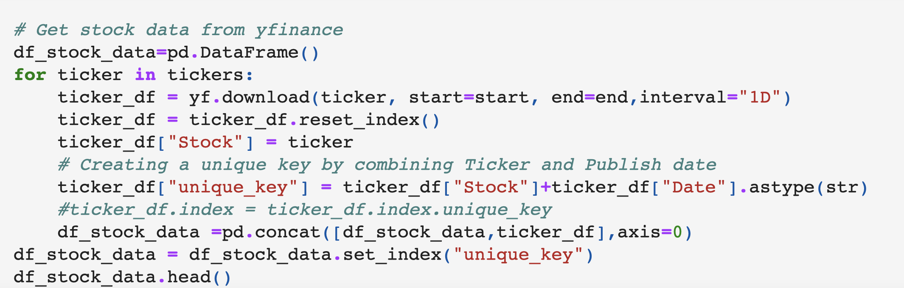
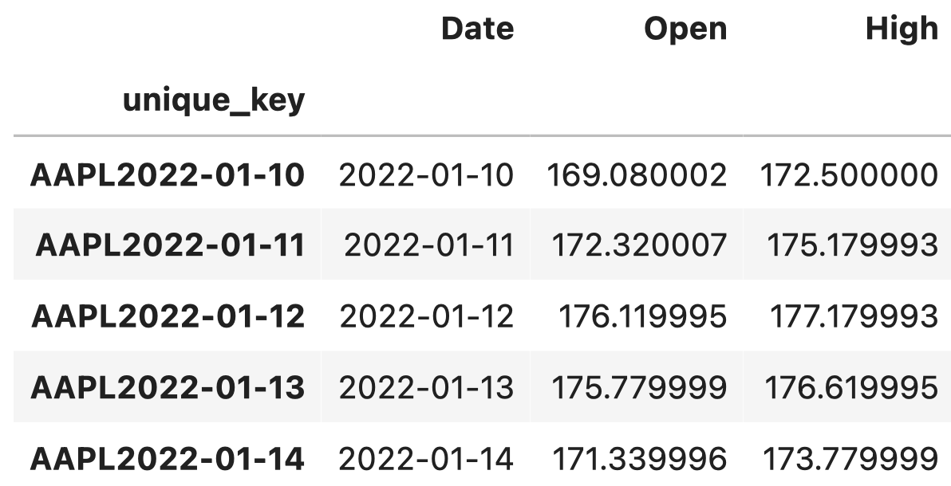
STOCK DATA PREPARATION
Goal: Pull daily “Volume”, ”Open”, ”Close”, ”High”, and “Low” stock data for the largest companies in the S&P500 using Yahoo Finance API
Method: Generated list of tickers ranked by market cap from csv accessible publicly and generated DataFrame using ”for” loop; combined ticker and date to create a unique key and set as index

Slide 6
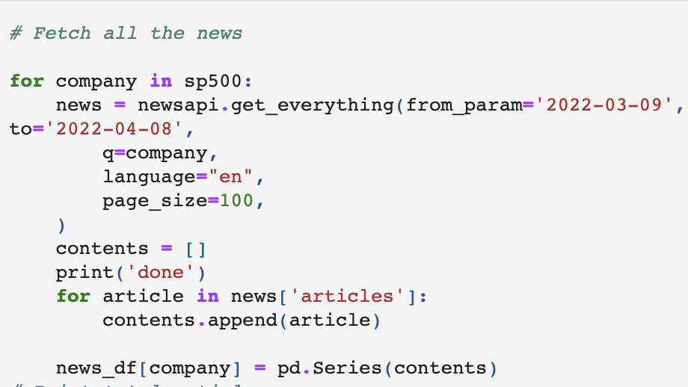
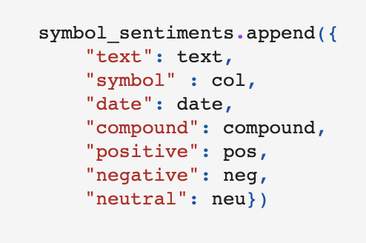
NEWS DATA PREPARATION
Goal: Use News API and VADER to pull articles mentioning an S&P 500 company and sequentially running the article through the sentiment analyzer
Method: Pull last 30 days of stock data (limit) for every ticker in our list; generate sentiment scores and generate a DataFrame with result

Slide 7
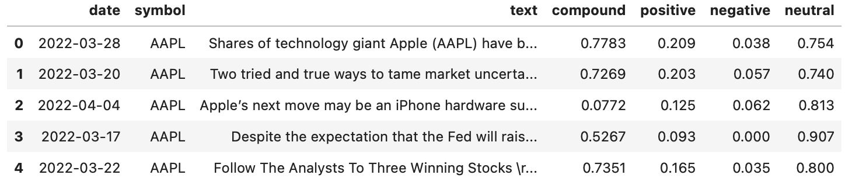
Completed News API DataFrame

Slide 8
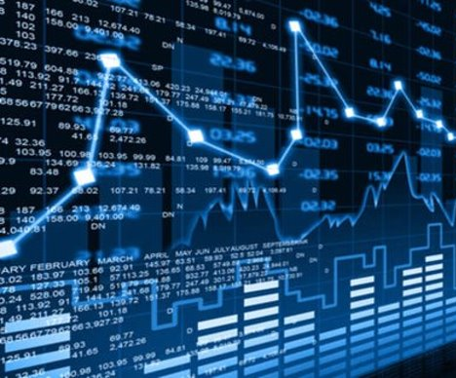
SENTIMENT ANALYSIS USING NEWS API
Using NLP techniques such as sentiment analysis we can find out (positive, negative, or neutral indicators ).
With the help of sentiment analysis, we can interpret the results.
Sentiment analysis tools generally process a unit of text (a sentence, paragraph, book, etc) and output quantitative scores or classifications to indicate whether the algorithm considers that text to convey positive or negative.

Slide 9
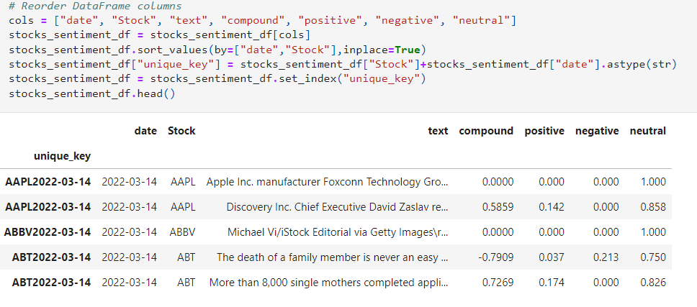
Sentiment Analysis with Vader

Slide 10
TECHNICAL INDICATOR DATA PREPARATION
Indicators
Simple Moving Average
Exponential Moving Average
Relative Strength
Average Directional Change
Momentum
Hilbert Transform - Dominant Cycle Phase
Hilbert Transform - Dominant Cycle Period
ADOSC-Chaikin A/D Oscillator
MFI- Money Flow Index
Typical Price
Hilbert Transform Trend vs Cycle Mode
Linear Regression
Normalized Average True Range
Process
Selected top 50 tickers from S&P500
Timeframe = 365 days
Pull data and calculate returns
Used a for loop to run 13 indicators stock data and return to a single dataframe
Save results to cvs file

Slide 11
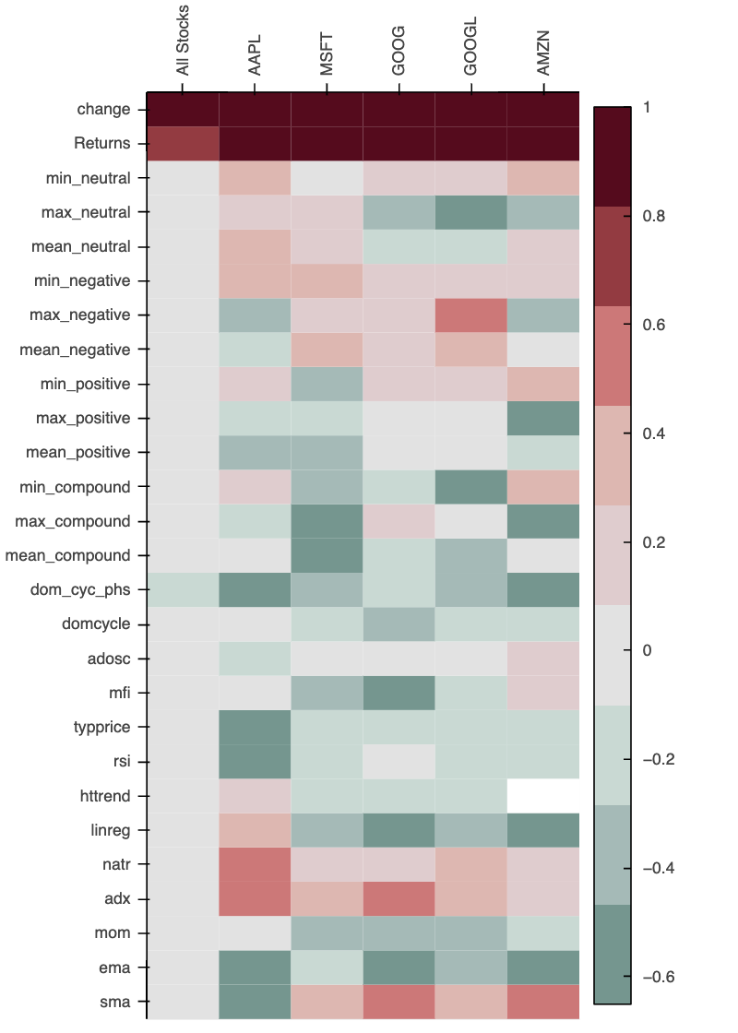
DATA ANALYSIS & EXPLORATION
Used correlation for exploratory data analysis
Results showed when all stocks were put together, the indicators became worthless, no correlation across all indicators
If indicators were run on individual stocks, then correlations were discovered
Running the models on a single stock was too little data for effective results, however running the models on all stock with the indicators will likely result in overfitting and return weak models

Slide 12
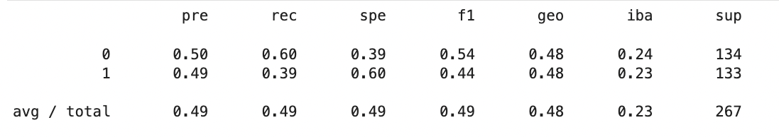

MODELING & TRAINING PROCESS
GRADIENT BOOST

Slide 13
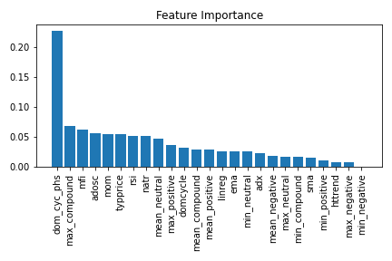
MODELS & TRAINING PROCESS
GRADIENT BOOST

Slide 14
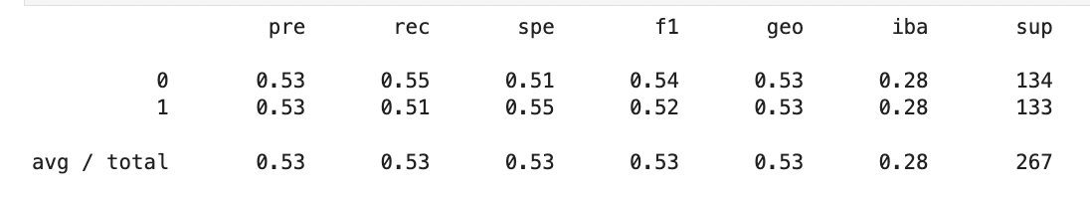
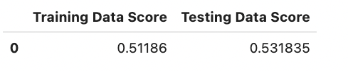
MODELING & TRAINING PROCESS
LOGISTIC REGRESSION

Slide 15
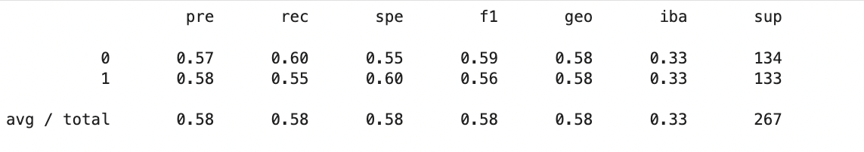
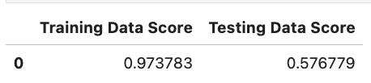
MODELING & TRAINING PROCESS
RANDOM FOREST

Slide 16
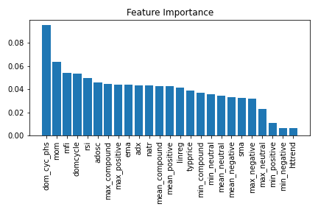
MODELS & TRAINING PROCESS
RANDOM FOREST

Slide 17
CONCLUSION
From Project 1, the results indicated that when sentiment was defined as a key word trends, the resulting affect on stock price was weak. This result seemed to make sense since many other factors have a stronger affect on stock price movement than current popularity of a searched word(s).
From Project 2, the results indicated that financial ratios that measure cash and profitability have the strongest affect on model prediction of stock prices movement. This results also seems to make sense since a company’s ability to generate and hold onto cash are closely tied to the value of the company.
From Project 3: the number of technical overfitted the model and overpowered the effect of sentiment analysis. The model results overall were weak with Random Forest being the strongest and Gradient Boosting being the weakest (the more the model learned, the more if overfit).

